Slide 1
Sales Performance Report
Temitayo Akinbinu
26th March, 2025

Slide 2





Brief Overview
Objective
Evaluate the company’s sales performance across regions and product categories from 2010 to 2013
Key Metrics
Total sales, Region, Product category, Customer segment, Year-Over-Year Growth
Scope
Superstore dataset from 2010 to 2013
Key Findings
Total Sales: $8,862,242.30
Total Profit: $1,312,442.40
Decline in Sales: South Region had the lowest contribution, accounting for 17% of total sales
Overall Business Status: Positive

Slide 3
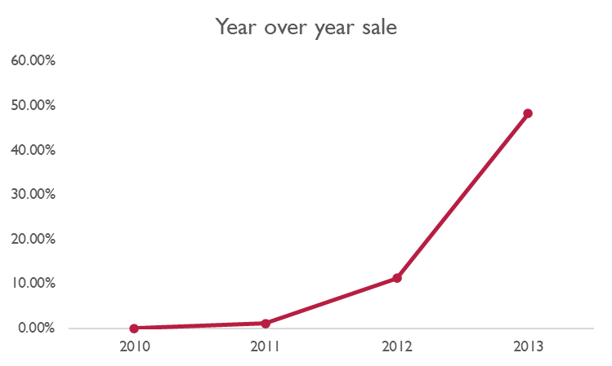
Key Findings & Insights
Total Sales increased by 48.23% year over year, driven
majorly by growth in the Central region.
The South region had the lowest contribution, accounting for
only 18.02% of the total sales.

Slide 4
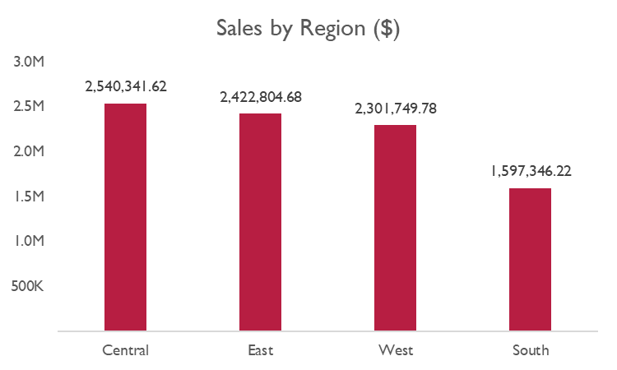
The Central region recorded the most sales,
contributing 28.66% of the total sales.
The South region had the lowest contribution,
accounting for just 18.02%

Slide 5
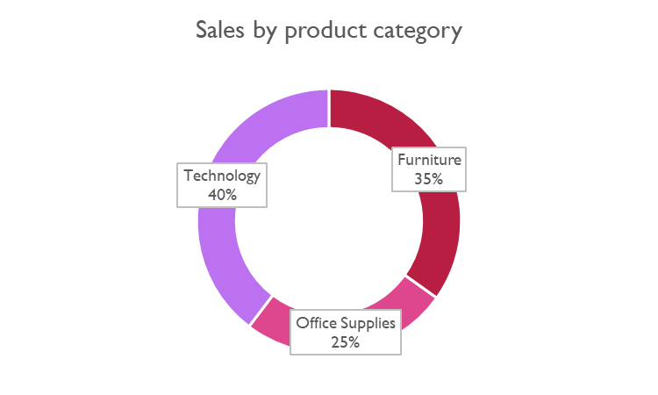
Products in the technology category experienced the most
significant growth, contributing 40% of the total sales.
Global Troy™ Executive Leather Low-Back Tilter showed
the highest sales growth, accounting for 2.19% of the
total sales.

Slide 6
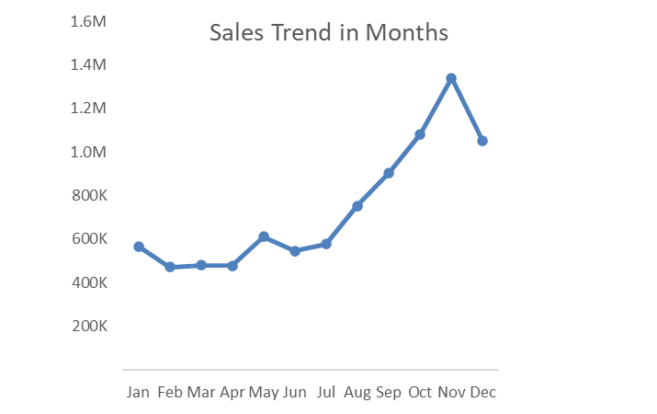
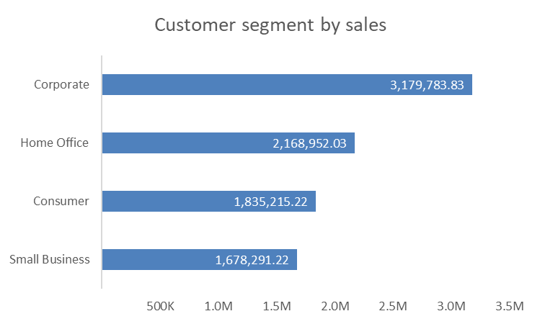
Sales showed a steady increase from June, reaching
their peak in November, which accounted for 26.03%
of the total sales.
Corporate customers achieved the highest sales performance, accounting for 35.88% of the total sales.

Slide 7
Conclusion & Next Steps
A substantial portion of consumers are corporate, making up 35.88% of the total consumers. Additionally, 44% of the products purchased by corporate consumers fall under the technology category.
November recorded the highest sales, contributing 26.03% of the total, indicating seasonal demand.
Marketing and awareness efforts should be strategically intensified in November, as it demonstrated the highest sales performance.
Continue monitoring sales trends and adjusting strategies as needed.

Slide 8
Recommendations
A detailed review of operations is recommended to address low sales in the South region.
Investigate the factors contributing to the significant growth in 2013 and strategically introduce them into operations.
Set achievable targets based on previous performance.

Slide 9
Q&A

